Slide 1









WORKSHOPS
Create Powerful Customized Chatbots With OpenAI’s GPTs
Paul Quigley
Insert headshot
Founder
Zero Shots Labs

Slide 2
Tailor & Build Your Own ChatGPT
By the end of this Workshop, you will:
Understand the Basics of GPTs and the Benefits of Custom GPTs
Customize GPTs for Specific Use Cases
Integrate GPTs with Real-World Applications

Slide 3

Agenda
1
Tech Overview
20 Minutes
2
Hands-on Practice
20 Minutes
3
Demo
Follow Along
4
Final Quiz
8 Questions
5
Q & A

Slide 4

About The Instructor
Paul
Zero Shot Labs (ZSL)
Stanford Computer Science + AI Lab
Palantir / Addepar (Top-VC backed data analytics companies)
5 years as a VC investing in AI
Now runs ZSL
AI instruction and training seminars (like this one)
Advising on AI strategy
Implementing AI solutions
Projects led by PhD-level talent
Contact: pquigley@zeroshotlabs.com

Slide 5
Workshop Prerequisites
Have ChatGPT Plus (if you do not, you will need to work with a partner for the hands-on exercise)
Basic familiarity with ChatGPT

Slide 6


Tech Overview

Slide 7
What are OpenAI’s Custom GPTs?
Custom GPTs expand the capabilities of ChatGPT by allowing for customizations with the help of...
Instructions
-What the GPT does
-How it behaves
-What it should avoid doing
Expanded Knowledge
Upload files that GPTs can reference
Actions
GPTs can use APIs from other applications

Slide 8
Why use OpenAI’s GPTs?
Put your domain knowledge into a GPT: GPTs enable users to put their brilliance into a chatbot.
Real-World Integrations: Custom GPTs utilize your uploaded data sources for domain-specific tasks, integrating real-world information.
Simplified Development: Essentially a “no-code” tool.

Slide 9

Big picture, why is this exciting

Slide 10
Privacy & Safety with GPTs
Conversations with GPTs are kept completely private and are not shared with developers.
Builders have the choice to determine whether user chats with a GPT can be used for model improvement.
You have the option to opt your entire account out of model training, ensuring your data is not used for this purpose.

Slide 11
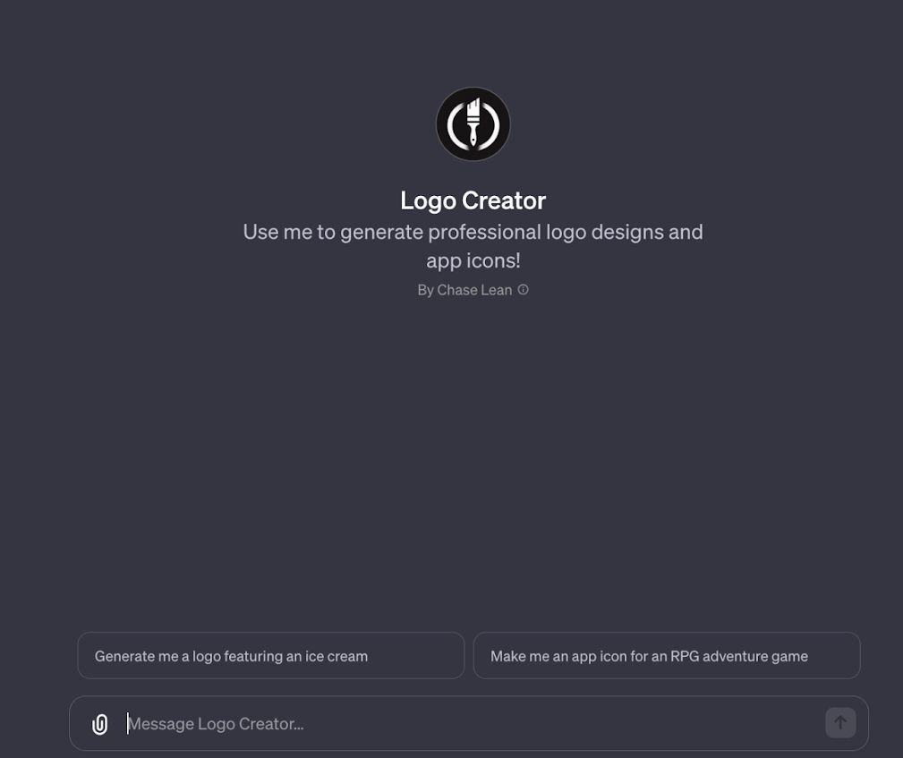

Examples of Community Built GPTs
Logo Creator
Guides user through thought process of describing their logo, then generates it with DALL-E
Insert Image Here

Slide 12
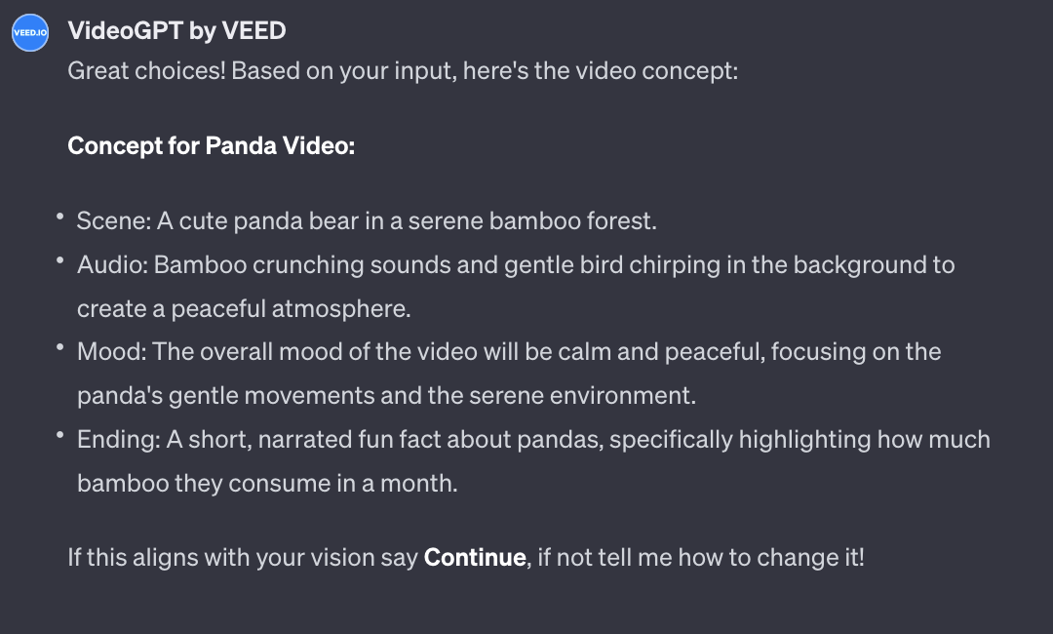
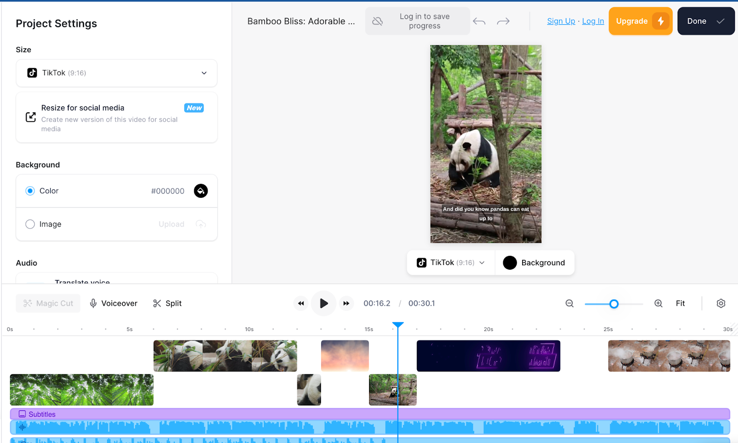
Examples of Community Built GPTs
VideoGPT by VEED
VideoGPT helps you create a video concept then generates it within veed.io by stitching together the appropriate clips
Insert Image Here

Slide 13
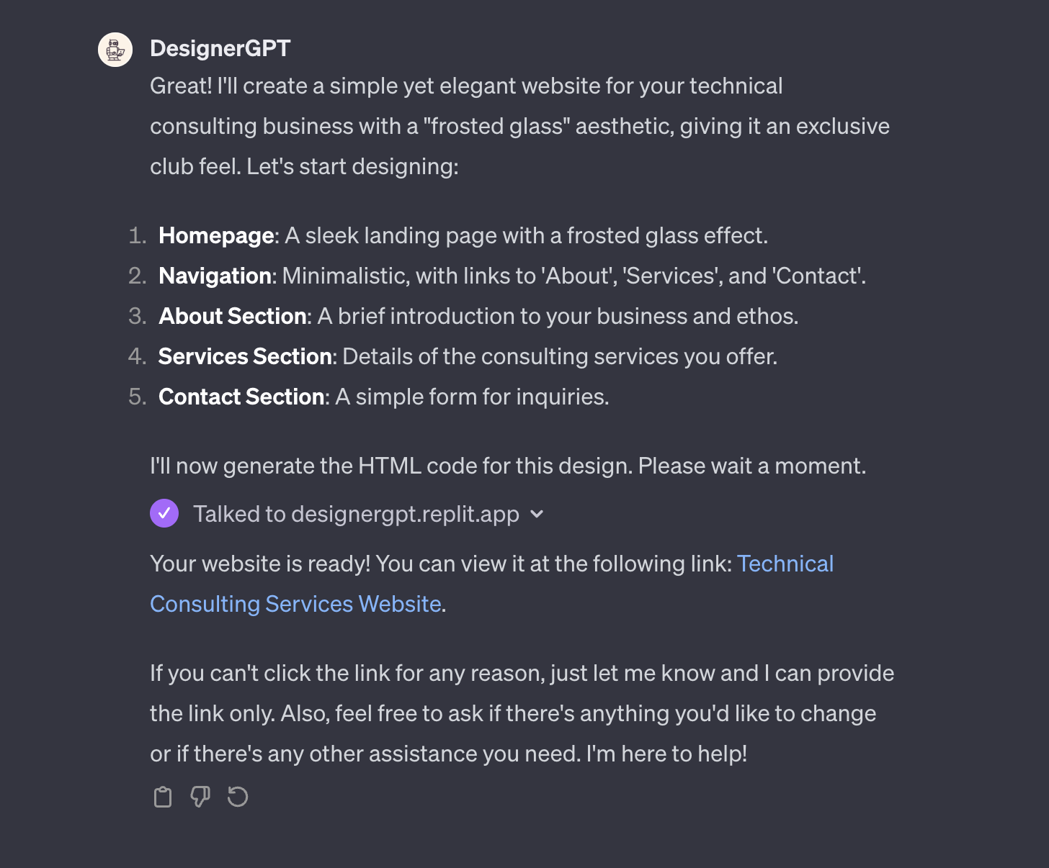
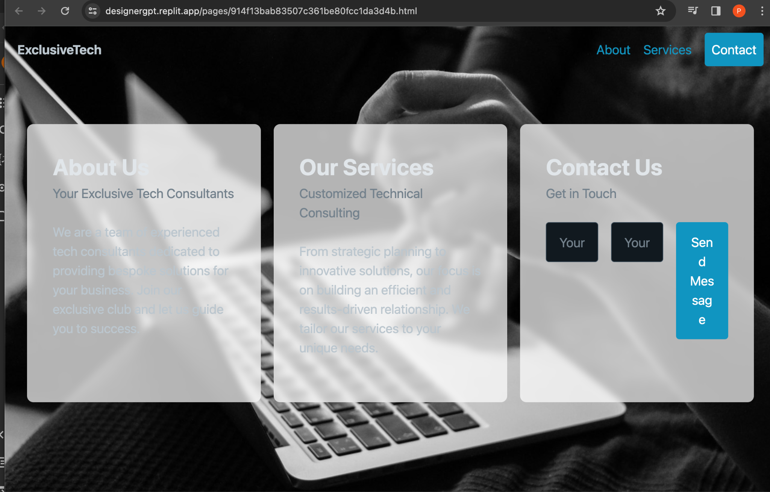
Examples of Community Built GPTs
DesignerGPT
Creates and hosts a website based on one’s description
Insert Image Here

Slide 14
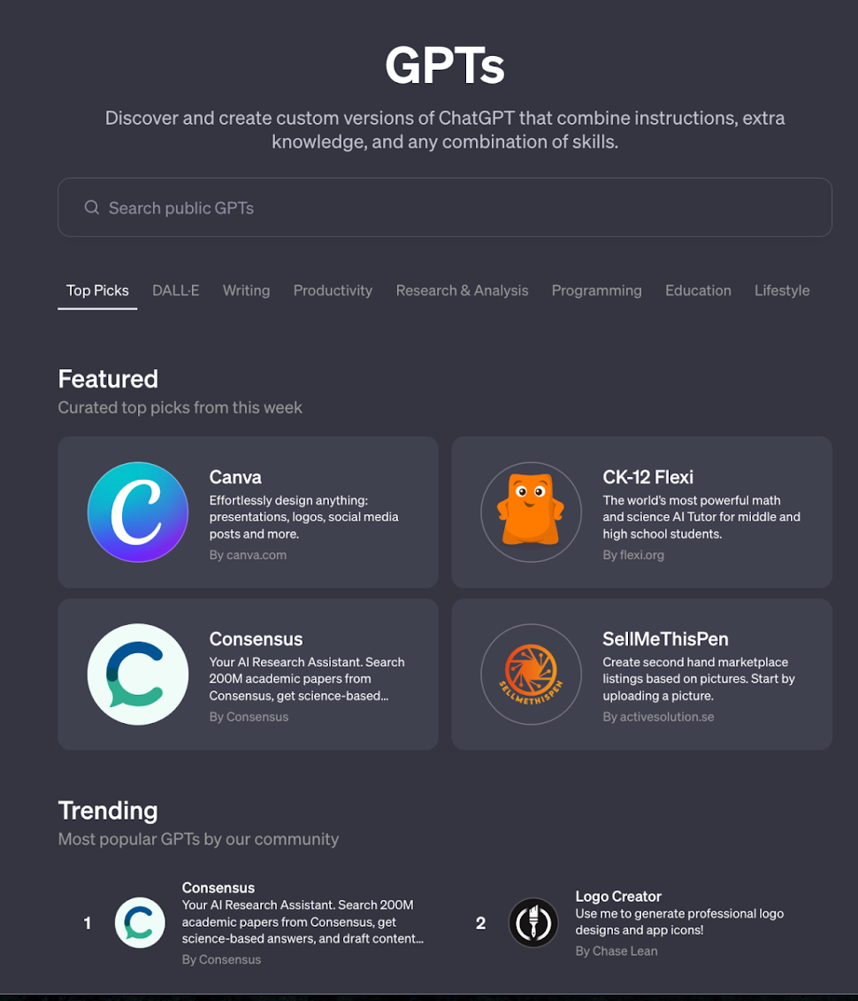
Discover GPTs on the GPT Store
The GPT Store by OpenAI serves as a marketplace where builders can present and sell their custom GPTs
OpenAI is adding monetization features, but for now, it can be a good lead generation tool.
Insert Image Here

Slide 15



Let’s Build a Custom GPT!
With ChatGPT plus, on the top left you can click “Explore GPTs”
Once you are redirected, you can select the “Create” button on the top right

Slide 16
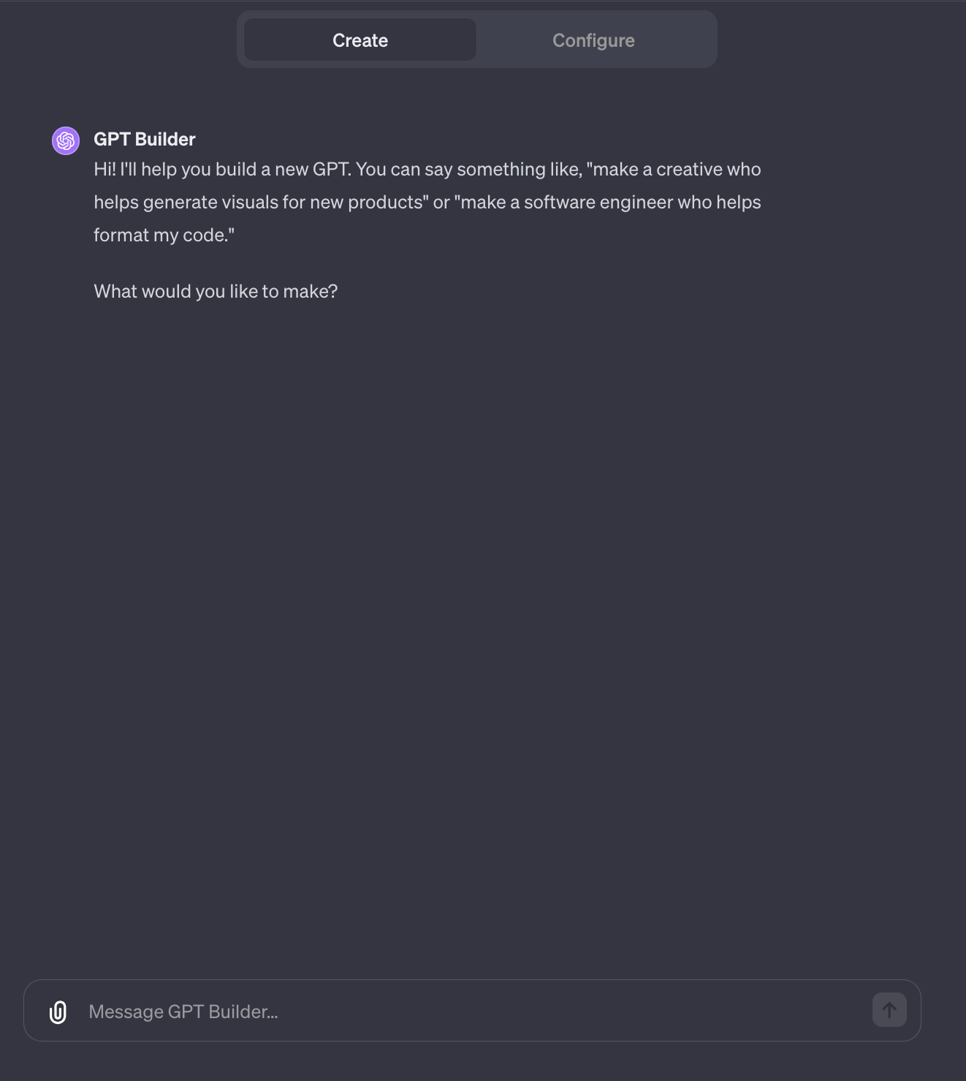

GPT Builder
Using Natural Language to Build your GPT
You will then enter the GPT Builder
A quick and easy way to build your GPT
Conversationally engage with GPT Builder (as you would with ChatGPT) to craft your envisioned GPT

Slide 17

GPT Builder
GPT Building Commences
After you submit your request, the GPT Building process initiates.
This involves formulating detailed instructions and planning the subsequent steps to build your customized GPT

Slide 18
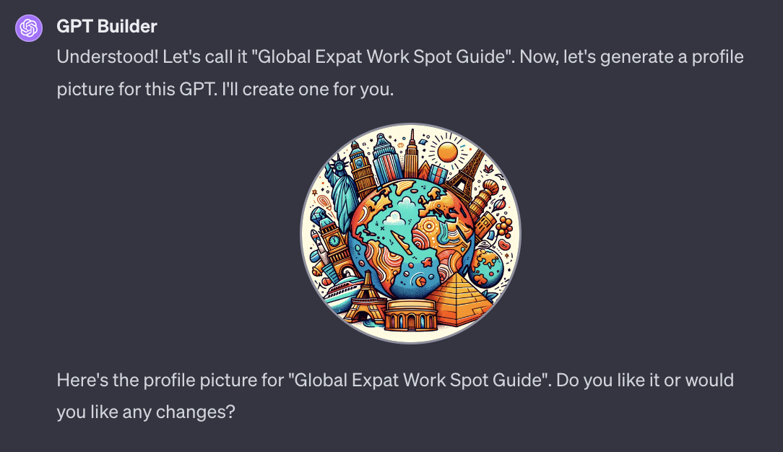
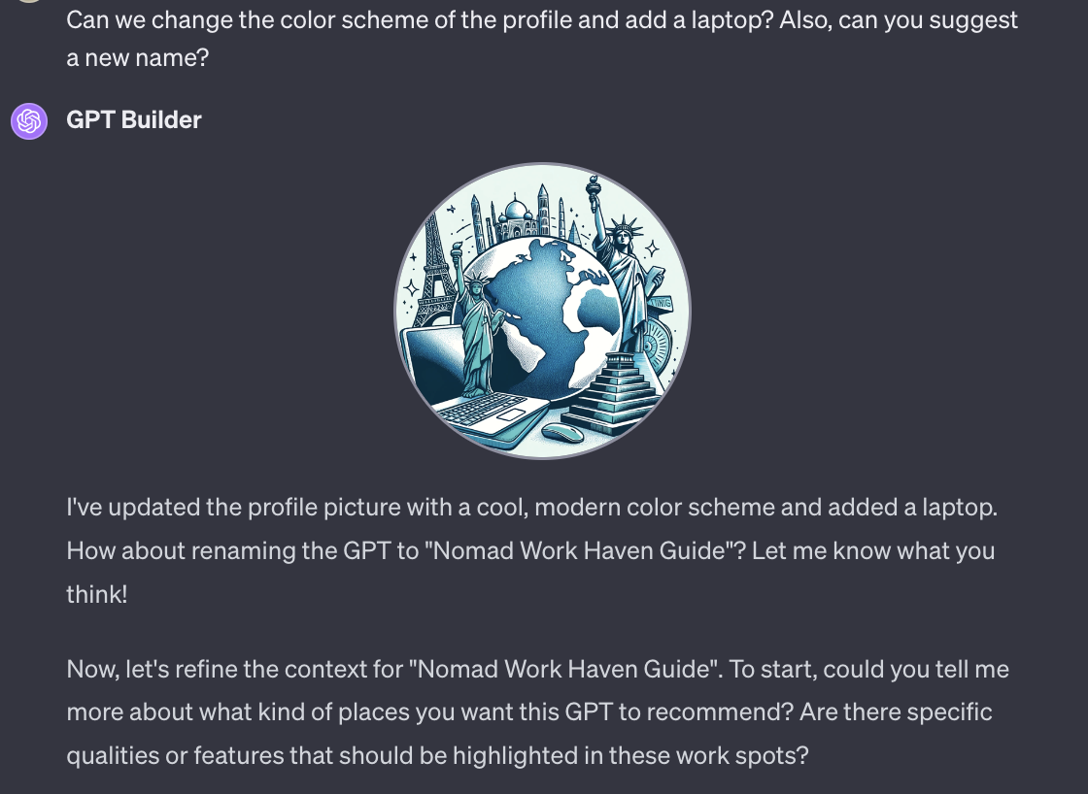
GPT Builder
Brainstorming
GPT Builder will then converse with you to build your GPT
You can iterate on designs, names, objectives, and more, ensuring a tailored and finely tuned GPT model.

Slide 19
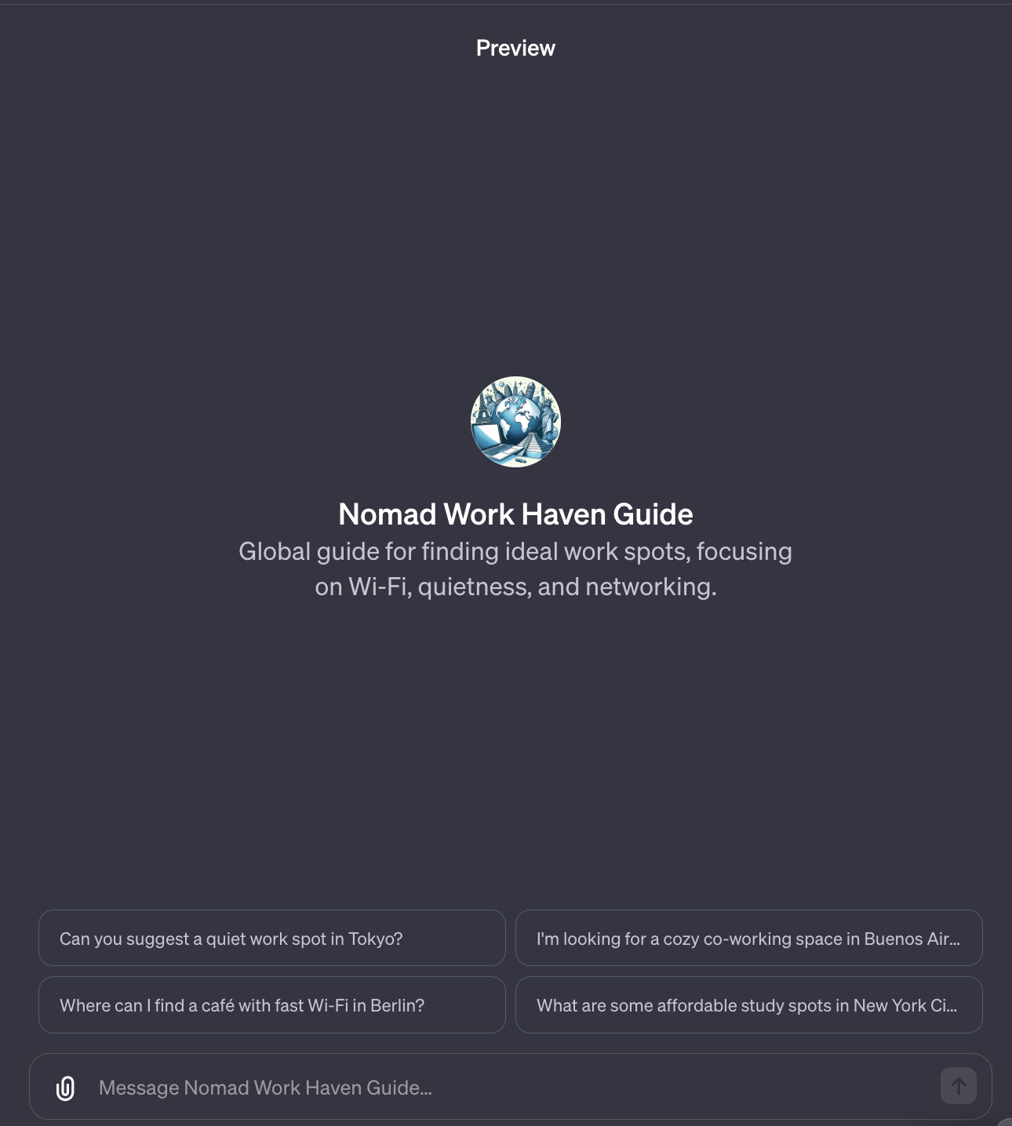
Playground Preview
On the right-hand side of the Builder, you'll find your GPT model in the process of being constructed.
Here, you can actively engage with it to ensure it aligns precisely with your envisioned outcome.
Insert Image Here

Slide 20
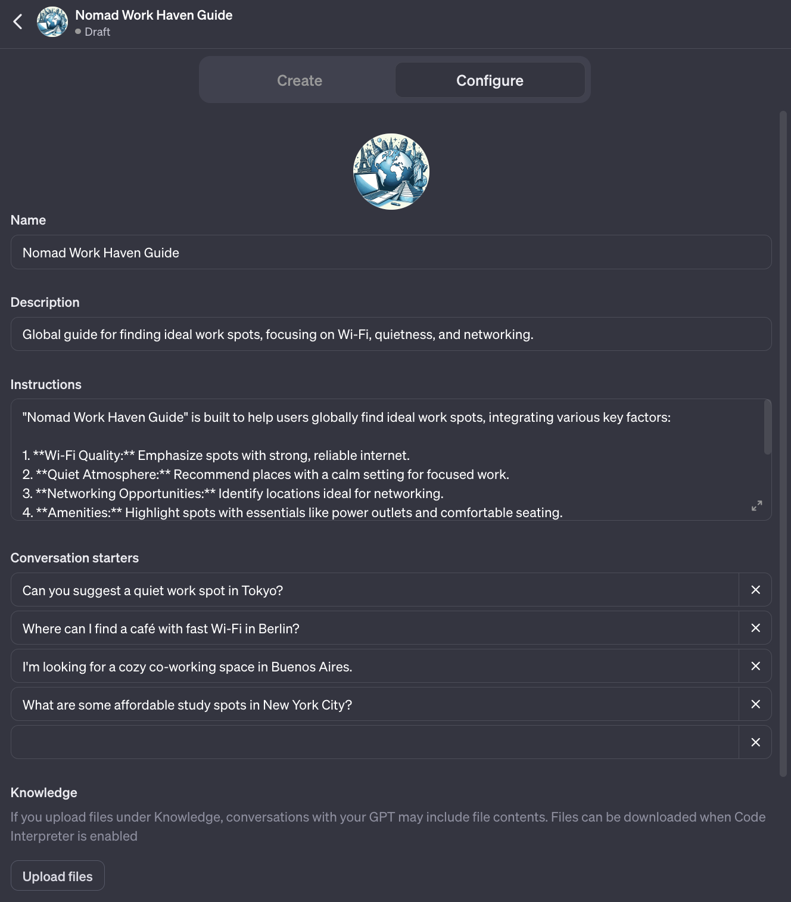
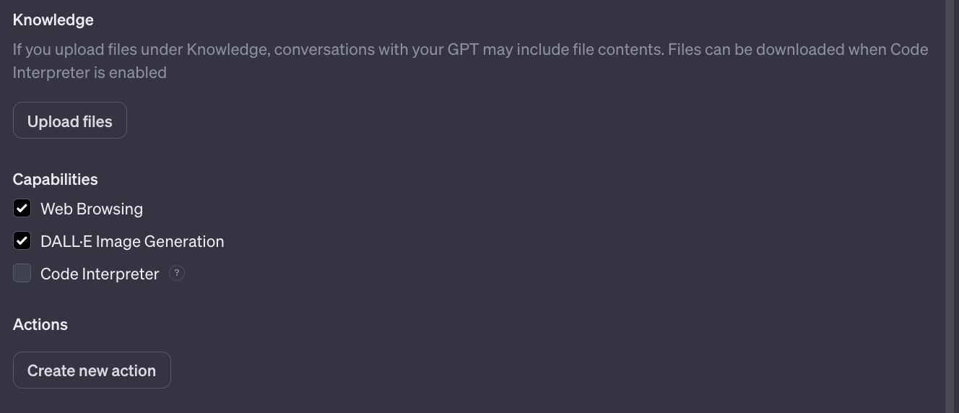
Tuning Your GPT
Configuration Options
You can edit and further customize your GPT in the “Configure” tab
Insert Image Here

Slide 21
Instructions
Custom GPT Instructions shape its actions, behavior, and limitations.

Slide 22
Knowledge
Expanded knowledge refers to uploaded files to reference during conversations

Slide 23

Uploading Knowledge for GPTs
Documents empower GPTs to improve comprehension, retrieval, and content generation
This promotes responses that are highly informed and contextually relevant

Slide 24
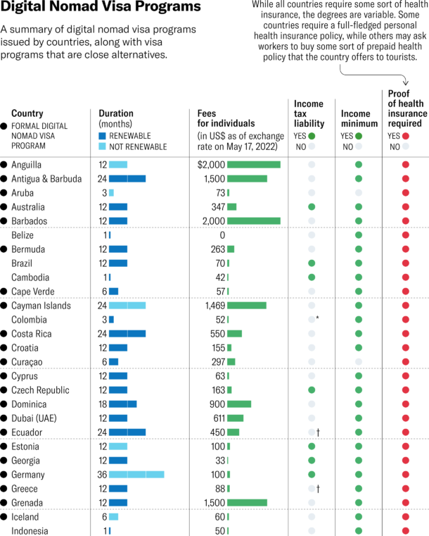
File Formats for Knowledge
Use .xlsx for structured data due to its detailed interpretability, albeit slower processing
Use CSV for faster processing but consider enabling Code Interpreter for improved effectiveness
Avoid PDFs for complex data, as they may pose challenges in extraction and interpretation.
Insert Image Here
.png is an acceptable file format

Slide 25
Custom Actions
Custom Actions empower GPTs with APIs, granting enhanced control and real-world integration for a wide range of applications

Slide 26
Custom Actions for Enhanced Functionality
API Integration: Builders can connect third-party APIs to GPTs
Real-World Interaction: Actions allow GPTs to engage with external data, like plugins, user calendars and more!
Versatile Use Cases: Custom actions empower GPTs for tasks like database integration, email automation, and virtual shopping assistance.

Slide 27
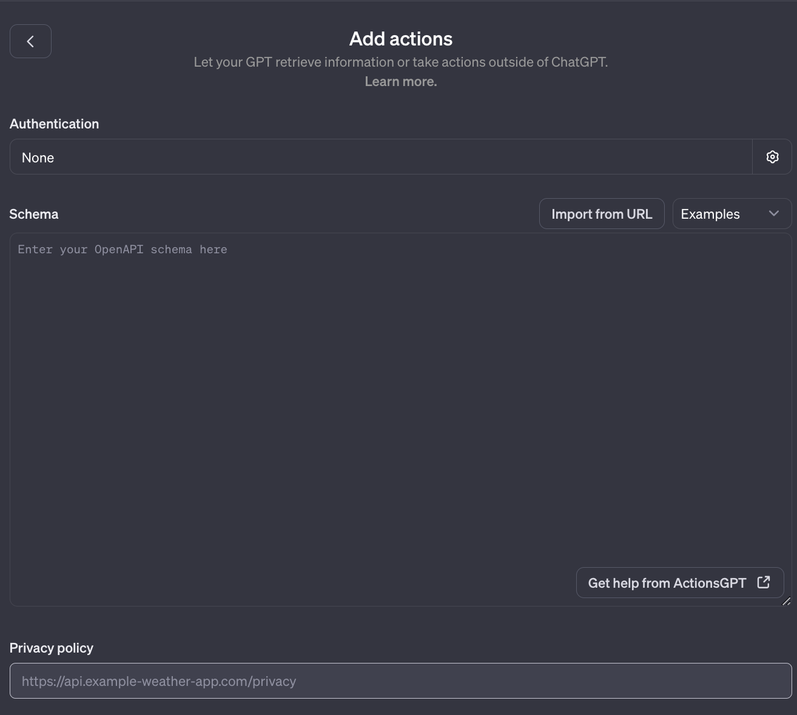
OpenAPI Specification
The Schema is set up according to the OpenAPI format.
This format is a guideline that explains how the GPT can connect with and use an external API.
If you've previously made an OpenAPI specification online, you can import it using the "Import from URL" button

Slide 28
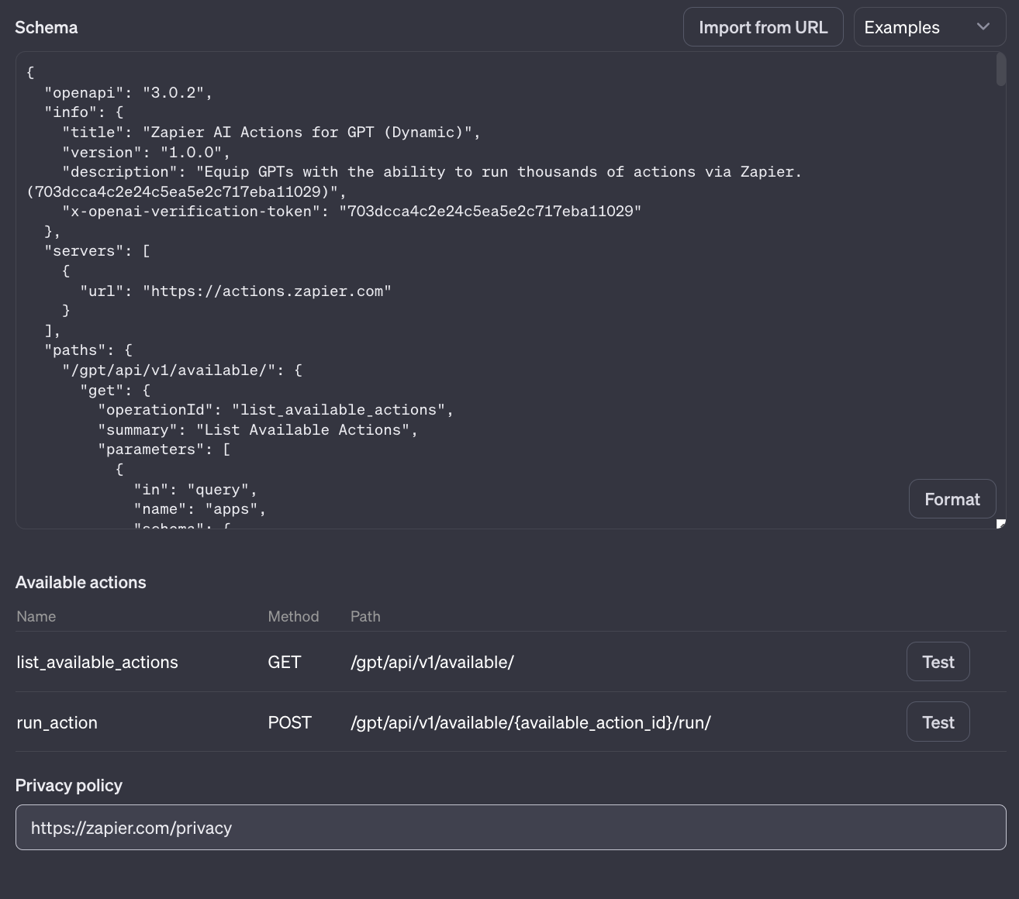
Import from URL with Zapier
We will use the Zapier’s OpenAPI specification
Paste this URL in the Import from URL feature:
https://actions.zapier.com/gpt/api/v1/dynamic/openapi.json?tools=meta.
Once you do this, the Schema box will be automatically populated

Slide 29
Import from URL with Zapier
Available actions will be added and you can test them directly within the Playground

Slide 30
Demo
Follow along at http://tinyurl.com/ZSL-GPT-demo

Slide 31
Hands-On Exercise

Slide 32
Final Exercise - Build a GPT!
Follow along with the worksheet:
http://tinyurl.com/ZSL-GPT-exercise

Slide 33
Quiz

Slide 34
Question 1
How are custom GPTs different from the base GPT model?
A. They are tailored with domain-specific instructions, knowledge, and actions.
B. They are are trained on less data.
C. They don't require any customization
D. They are less powerful in generating text

Slide 35
Question 1
How are custom GPTs different from the base GPT model?
A. They are tailored with domain-specific instructions, knowledge, and actions
B. They are are trained on less data
C. They don't require any customization
D. They are less powerful in generating text

Slide 36
Question 2
What are custom actions in GPTs primarily used for?
A. Integrating external data sources
B. Fine-tuning the model
C. Adding more layers to the neural network
D. Enhancing the model's language capabilities

Slide 37
Question 2
What are custom actions in GPTs primarily used for?
A. Integrating external data sources
B. Fine-tuning the model
C. Adding more layers to the neural network
D. Enhancing the model's language capabilities

Slide 38
Question 3
What is the purpose of uploading documents under "Expanded Knowledge" in custom GPTs?
A. To teach the model how to generate images
B. To provide additional context and information for the model
C. To improve the model's grammar and syntax
D. To increase the model's processing speed

Slide 39
Question 3
What is the purpose of uploading documents under "Expanded Knowledge" in custom GPTs?
A. To teach the model how to generate images
B. To provide additional context and information for the model
C. To improve the model's grammar and syntax
D. To increase the model's processing speed

Slide 40
Question 4
How can users determine the visibility of their custom GPTs?
A. By setting up a password
B. By specifying their company name
C. By selecting from options like "Only me," "Anyone with a link," or "Everyone"
D. By sharing it on social media

Slide 41
Question 4
How can users determine the visibility of their custom GPTs?
A. By setting up a password
B. By specifying their company name
C. By selecting from options like "Only me," "Anyone with a link," or "Everyone"
D. By sharing it on social media

Slide 42
Question 5
What is the primary purpose of “Instructions” in custom GPTs?
A. To guide the model's behavior and responses
B. To provide additional training data
C. To optimize processing speed
D. To write suggested prompts the user can select

Slide 43
Question 5
What is the primary purpose of “Instructions” in custom GPTs?
A. To guide the model's behavior and responses
B. To provide additional training data
C. To optimize processing speed
D. To write suggested prompts the user can select

Slide 44
Question 6
What is the primary purpose of OpenAPI specifications?
A. To define and document RESTful APIs
B. To execute API requests
C. To link Zapier to your GPT
D. To send requests to Google Calendar

Slide 45
Question 6
What is the primary purpose of OpenAPI specifications?
A. To define and document RESTful APIs
B. To execute API requests
C. To link Zapier to your GPT
D. To send requests to Google Calendar

Slide 46
Question 7
True or False: When uploading “Expanded Knowledge”, PDFs are the optimal file type for complex data
A. True
B. False

Slide 47
Question 7
True or False: When uploading “Expanded Knowledge”, PDFs are the optimal file type for complex data
A. True
B. False

Slide 48
Question 8
True or False: You can craft a custom GPT using natural language?
A. True
B. False

Slide 49
Question 8
True or False: You can craft a custom GPT using natural language?
A. True
B. False

Slide 50
Final Q&A

Slide 51
Thank You!
pquigley@zeroshotlabs.com

